Slide 1
Hardware-Software Co-design of K-means algorithm
Presented By:
Aatib Mohammad 2022H1230239P
Nikhil Gupta 2022H1230253P
Amurt Prakash 2022H1230254P
Avadh Harkishanka 2018HS230322P

Slide 2
Content
FPGA vs CPU
Basic Idea of Zynq
Zynq SOC block diagram
System View Diagram of ZYNQ
Zynq-7000 Main Features
PS Main Components
Application Processing Unit (APU)
On chip memory
DMA controller
PL Main Components
AXI (Advanced eXtensible Interface)
AXI Interconnect
PL/PS AXI Interfaces
Booting of Zedboard
Specifications of ZedBoard ZYNQ 7020
Physical overview of Zedboard
ZYNQ-7000 Data Sheet
K-means Clustering
Hardware and Software Co-design of K means algorithm
Data set and expected results
Design-1/2/3 block diagram
RTL (for PL part)
Implemented design schematic
Device mapping
Vitis IDE results
Device Utilization
Conclusion
Learning Outcome

Slide 3
FPGA vs CPU
What is CPU?
•Central processing units, or CPUs, have been used for many years. A CPU is a chip that sequentially carries out a program based on a predetermined set of instructions. While CPUs are ideal for single-process systems where code must be performed sequentially or linearly, they fall short in parallel implementation.
•The internal hardware layout of the CPU is predetermined by the CPU vendor and is immutable. Many CPUs are general purpose, meaning they can carry out any task depending on the software that is put into them. Since they are general-purpose chips, they don't offer any unique hardware advancements like faster video compression offered by specialized hardware blocks.
What is FPGA?
An FPGA is a chip with several logic building blocks that the user can change and modify. As a result, these chips provide the user with a lot more adaptability and freedom while carrying out particular operations that call for quick results. Due to its electronic wiring in the form of discrete programmable logic blocks that may be tailored to the user's requirements, FPGAs are perfect for parallel systems where numerous tasks must be carried out at once. Since FPGAs are programmable semiconductors, their functionality can be changed repeatedly.

Slide 4
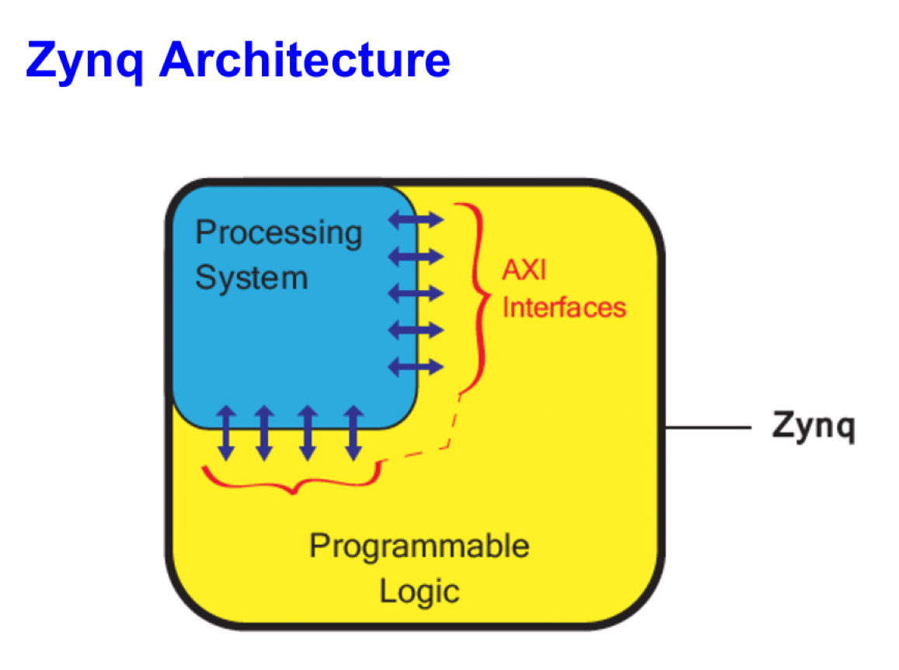
Basic idea of Zynq
People then combined a CPU unit and an FPGA to create a single device that has the capabilities of both in order to get the best of both worlds (Hardware software co-design). The final solution is very adaptable and effective in its work since the FPGA logic blocks are used for specialised, unique jobs that can be tailored to your needs, while the CPU section handles the majority of complex data processing and decision making, largely general computing.
Thus, the basic idea was to combine the best of both the worlds and thus came ZYNQ architecture.

Slide 5
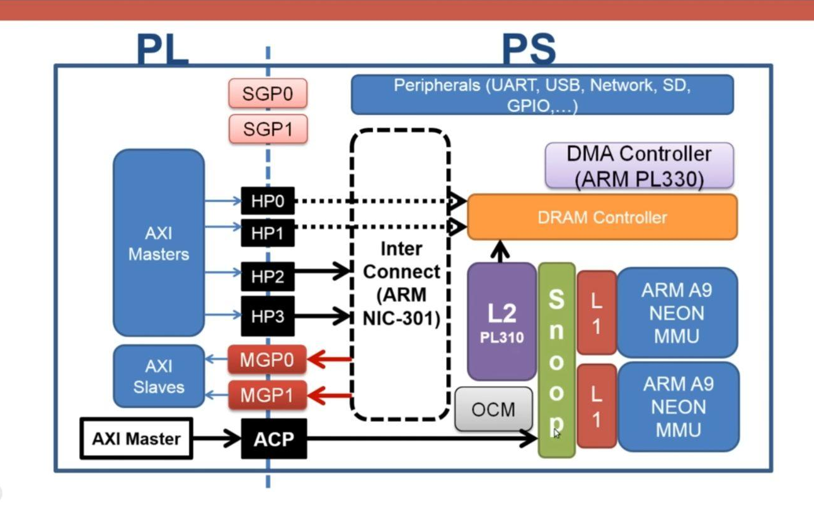
Zynq SOC block diagram
On a high abstraction level we can divide architecture of Zynq in three parts:
Programming Logic,which is your reconfigurable architecture
Processing system, which does your general purpose computing
AXI interfaces to facilitate the high bandwidth and low latency connection between PS and PL.

Slide 6
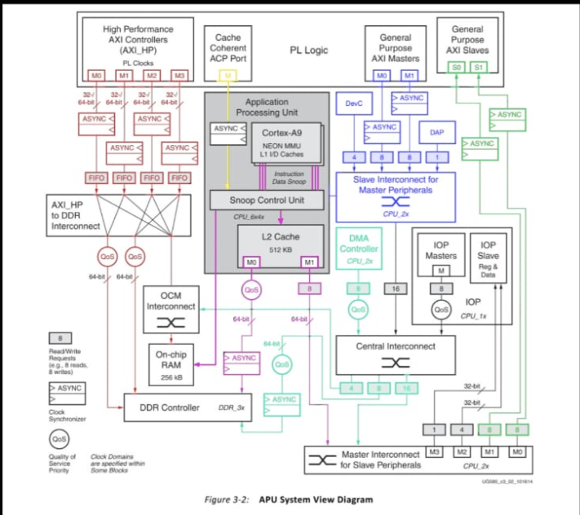
System View Diagram of ZYNQ

Slide 7
ZYNQ-7000 Main Features
As depicted in the previous slides, some of the main components of ZYNQ are:
Complete ARM- based processing system (PS)
Application Processor Unit (APU)
Dual ARM Cortex A9 processors
Caches and support blocks
Fully integrated memory controllers
I/O peripherals
Tightly integrated programmable logic (PL)
Used to extend the processing system
Scalable density and performance
Flexible array of I/O and advanced extensible Interface (AXI)
Wide range of external multi-standard I/O
High performance integrated serial transceivers
Analog to digital converter inputs

Slide 8
PS main components
Dual Core ARM cortex A9 processor (Harvard Architecture)
Has allotted instruction level-1 cache (32KB)
Interrupt controller
Shared level-2 cache of 512 KB
Snoop control Unit
To keep contents of cache coherent
Makes sure either core of processor gets latest instance of variable.
Dedicated DRAM controller
Large number of peripherals
Direct memory access(DMA) controller
Responsible for transfer of data between different components of PS
Interconnects (ARM NIC-301)
Fast On chip memory (OCM) - 256 KB
Timers

Slide 9
Application Processing Unit (APU)
One processor, for single-core devices, or two processors, for dual-core devices, are housed in the application processing unit (APU), which is part of the PS. These are Arm Cortex-A9 processors that share a 512 KB L2 cache with NEON coprocessors. Two distinct 32 KB L1 caches for instructions and data are implemented in each processor, making each one a high-performance and low-power core. The Arm v7 architecture is used by the Cortex-A9 CPU. The media and signal processing architecture of the NEON co-processor adds instructions that focus on 3D graphics, audio, video, image, and voice processing.
The Cortex-A9 processor(s) in the APU are set up in an MP configuration, with a snoop control unit (SCU) in charge of ensuring that the two processors' L1 caches are coherent and that the ACP interface from the PL. A shared, unified level-two (L2) cache with a capacity of 512 KB is available for data and instructions to boost performance. A 256 KB on-chip memory (OCM) module that offers low-latency memory runs in parallel with the L2 cache.
The programmable logic (PL) and the APU can communicate more easily thanks to an accelerator coherency port (ACP). The PL can construct an AXI master that can access the L2 and OCM while preserving memory coherency with the CPU L1 caches thanks to this 64-bit AXI interface.

Slide 10
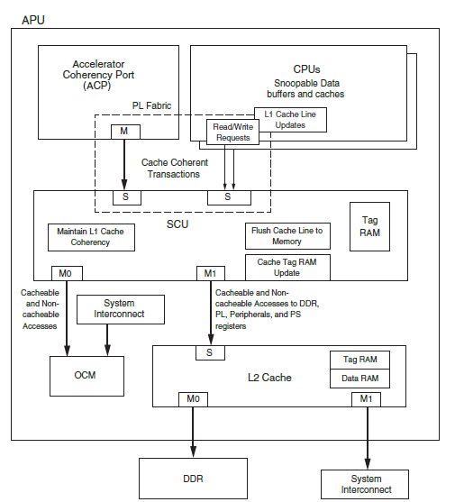
Application Processing Unit (APU)
Depending on the address of the access, all L2 cache controller accesses can either be delivered to the DDR controller or to other slaves in the PS or PL. A dedicated connector connects the L2 cache controller and DDR controller to reduce latency to the DDR memory.
Two L2 cache controller interfaces and an OCM interface that runs parallel to the L2 cache are the primary interfaces the APU uses to communicate with the rest of the system.

Slide 11
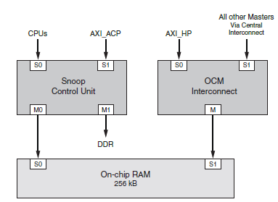
On chip memory
It is located in application processing unit of PS in ZYNQ architecture.
The on-chip memory (OCM) module contains 256 KB of RAM and 128 KB of ROM (BootROM). It supports two 64-bit AXI slave interface ports, one dedicated for CPU/ACP access via the APU snoop control unit (SCU), and the other shared by all other bus masters within the processing system (PS) and programmable logic (PL).
The BootROM memory is used exclusively by the boot process and is not visible to the user.
OCM system viewpoint

Slide 12
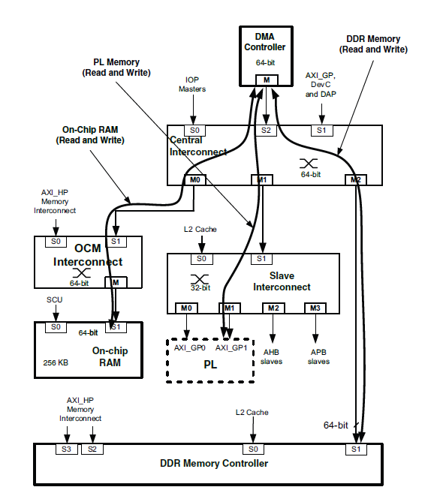
DMA controller
The DMA controller (DMAC) uses a 64-bit AXI master interface operating at the CPU_2x clock rate to perform DMA data transfers to/from system memories and PL peripherals.
The DMA controller is able to move large amounts of data without processor intervention. The source and destination memory can be anywhere in the system (PS or PL). The memory map for the DMAC includes DRAM, OCM, linear addressed Quad-SPI read memory, and PL peripherals or memory attached to an M_GP_AXI interface.
DMA transfers on AXI interconnect
All of the DMA transactions use AXI interfaces to move data between the on-chip memory, DDR memory and slave peripherals in the PL.
The data paths that are normally used by the DMAC are shown in sky blue colour in system view diagram of zynq in slide-6. Each AXI path can be a read or write.There are many combinations. Two typical DMA transaction examples include:
• Memory to memory (On-chip memory to DDR memory)
• Memory to/from PL peripheral (DDR memory to PL peripheral)
(above transaction path is also shown in the right half of the slide)

Slide 13
PL main components
The processors in the PS always boot first, allowing a software centric approach for PL configuration.The PL can be configured as part of the boot process or configured at some point in the future.Shares the same 7 series programmable logic as:
Artix™-based devices: Z-7010 and Z-7020 (high-range I/O banks only).
Kintex™-based devices: Z-7030 and Z-7045 (mix of high-range and high-performance I/O banks).
The main components of PL are:
Configurable logic blocks (CLB)
6-input LUTS
BRAM (36KB)
DSP48E1 Slice
Clock Management
Configurable I/Os
High Speed Serial Interfaces

Slide 14
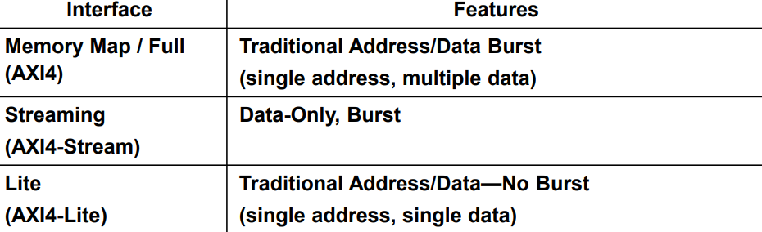
AXI (Advanced eXtensible Interface) Bus
AXI is an on-chip communication bus protocol developed by ARM.
When SOC sends Information between the modules some protocols should be present lets different module to talk to each other that is done by AXI.
AXI uses Industry standard Protocols, Vivado design flow is also based on AXI protocols
AXI can be classified on the bases of their feature as shown in below table:

Slide 15
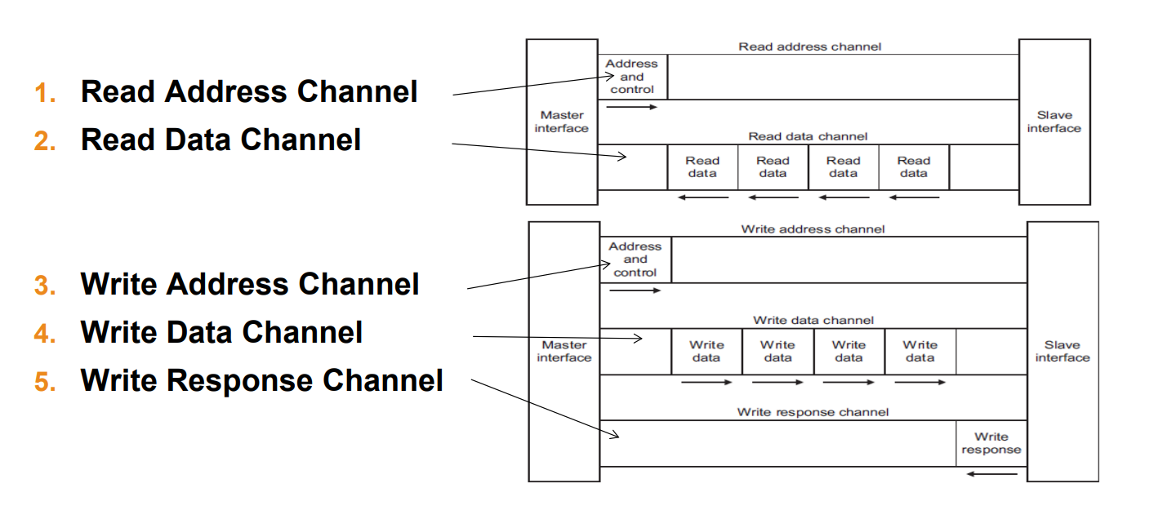
AXI (Advanced eXtensible Interface) Bus
AXI Master and AXI Slave: When Data is sent from one module to another. Module which send the data called as AXI Master and the module which receive the data is called AXI Slave.
AXI uses 5 channels for communicating between master and slave modules.

Slide 16
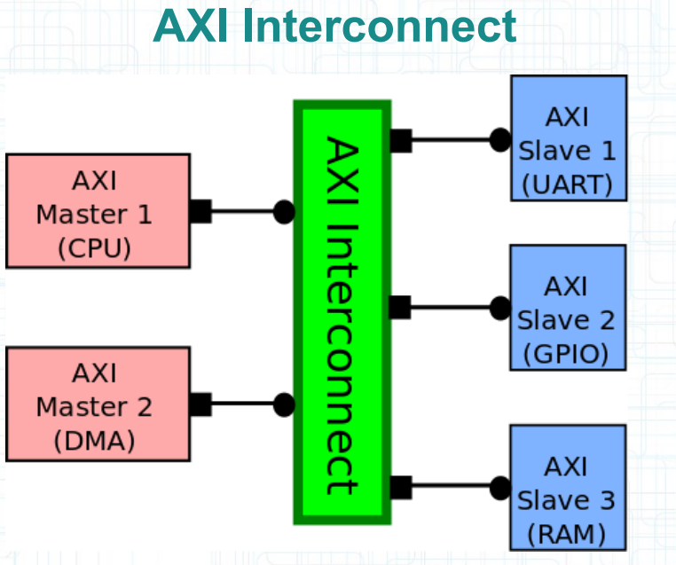
AXI Interconnect
For sending information from multiple master to multiple slave AXI Interconnects are used.
AXI Interconnect can send specific data to specific slave from specific Master
AXI are used for communicating between PS and PL Components of the SOC.
Zynq uses AXI4 for PL modules and AXI3 for PS modules.
(As AXI also has the capability to send 64kb of information to 32kb slave module.)

Slide 17
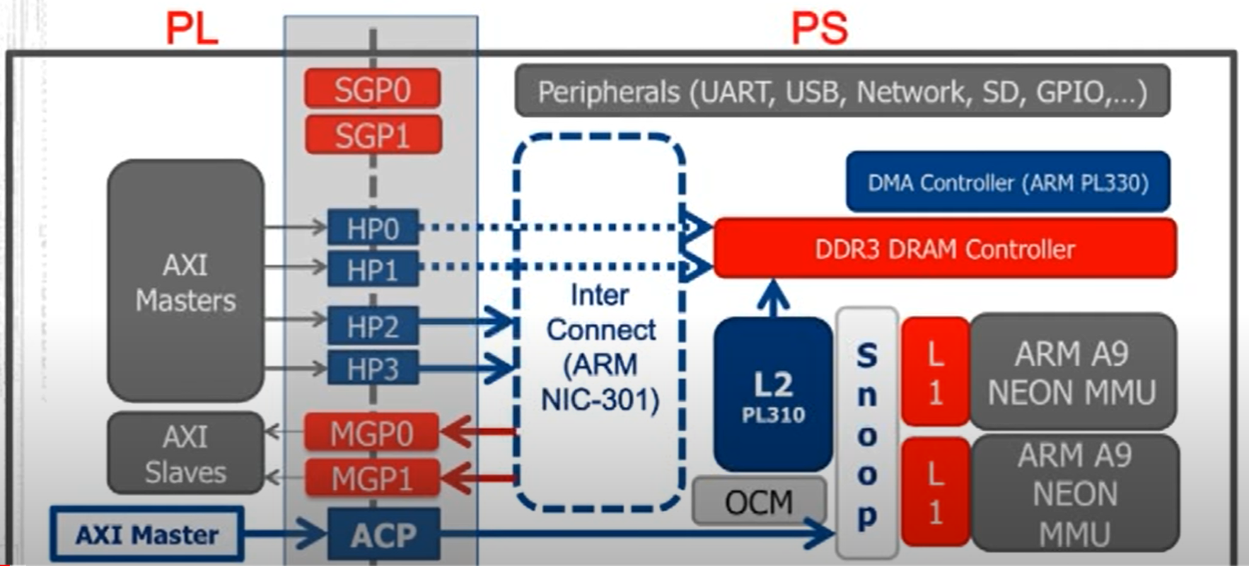
PL / PS AXI Interfaces
Communication ports

Slide 18
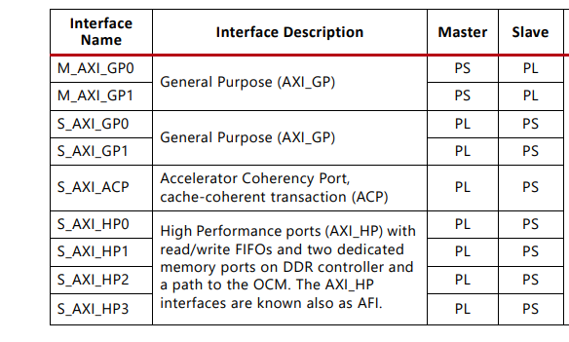
PL / PS AXI Interfaces

Slide 19
PL / PS AXI Interfaces
Different AXI interconnects are used such to enable transactions between PS/PL as described below:
High performance ports
They have following characteristics and applications:-
These are slave ports to the logic you develop in PL.
All are based on AXI memory interface, and enables high bandwidth transaction of 64 bits.
Helps in directing the hardware accelerator or logic in PL in memory space of PS i.e. OCM and DRAM. PL shares data to PS CPU core by transferring data to DRAM via these ports only and CPU can access the data later
Further categorized into HP0, HP1,HP2, and HP3.
HP0 and HP1 are used to access DRAM controller by which PL access the DRAM and OCM.
HP2 and HP3 are used for Interconnect of the PS which can be controlled by the PL.
(Note: Corresponding path related to this ports are highlighted by red ink in the APU system view diagram of ZYNQ-7000 in slide-6.)

Slide 20
PL / PS AXI Interfaces
(B) Accelerator Coherency Port (ACP)
In the domain of microelectronics there is a significant jump in performance per watt in the recent decades.
This was achieved by using specialized functional units called hardware accelerators.
Accelerators are modules created for a specific purpose rather than going for general purpose computing.
In the Zynq architecture the hardware accelerators for executing a specific function are configured in the PL part of the SOC and the general purpose computing of the desired application is performed in the PS part, both the parts then communicate with each other via the ACP (accelerator coherency port).
ACP (64 bit) also improves performance by introducing the concept of shared memory, as ACP port connects the AXI master of PL to the snoop control unit by which PL can directly access the latch memory of the core processor.
(Note: Corresponding path related to this ports are highlighted by yellow and pink ink in the APU system view diagram of ZYNQ-7000 in slide-6.)

Slide 21
PL / PS AXI Interfaces
(C) General Purpose Ports
These allow 32 bit low performance transactions.
Further classified as Master general purpose ports (MGP0,MGP1) and slave general purpose ports (SGP0,SGP1).
SGP0 and SGP1 are slave ports of PS which are used to enable transaction between PL and peripherals of PS.
MGP0 and MGP1 are the only master ports of the PS.
Through this CPU core and DMA engine of PS can initiate read and write transactions to the logic you develop in PL.
These ports can also be used by the CPU core to configure the PL logic.
(Note: Corresponding path related to this ports are highlighted by blue (MGP) and green (SGP) ink in the APU system view diagram of ZYNQ-7000 in slide-6.)

Slide 22
Booting of Zedboard
Normally processors is first booted by PS Master Mode (Primary configuration), allowing a software centric approach for PL configuration.
Primary configuration :
QSPI Flash
Auxiliary configuration :
JTAG
SD Card
Primary configuration
First Hardware resets all the registers and disable JTAG, DDR controllers.
Then ZedBoard uses a serial NOR flash (Quad SPI Flash Memory) located at the back of ZedBoard of size 256MB for BootROM execute in stage0.
Here Flash Memory is used to provide a non-volatile code and data storage which can be used to initialize the PS subsystem, as well as configure the PL subsystem (bitstream).
Expected configuration time using a 50MB/s QSPI flash is 250ms.

Slide 23
Booting of Zedboard
Auxiliary configuration (JTAG , SD Card)
First Three steps remain same while using auxiliary configuration.
(Hardware reset, stage 0 {PS,PL configure})
Now after basic configuration in stage 1, user code instructions are taken from SDcard (user code) and passed these instruction to OCM where PS’s core CPU0 and CPU1 execute the instruction line by line which we have provided in the SD card hence getting an auxiliary booting configuration.
Here bitstream is passed by SD card to the PS by OCM and hence configuring PL by using PS at the starting.
Now after setting up PS and PL part. In stage 2, JTAG or SD card can also be used to run an Operating System such as linux.

Slide 24
Specifications of ZedBoard ZYNQ 7020
ZYNQ 7000 is a family of similar SOC architecture:
ZYNQ 7020 (XC7Z020 -1 CSG484) {ZedBoard}
(-1) represent that this product is at lower end with lower frequency of operation for the ARM core processor.
484 represent the number of pins on the board
PL :
85K logic Cell
560 kbytes Block Memory
220 DSP slices
Where DSP slices are used for complex multiplications each has a range of 18 by 25 bits
DDR3 :
512MB off chip memory is available.

Slide 25
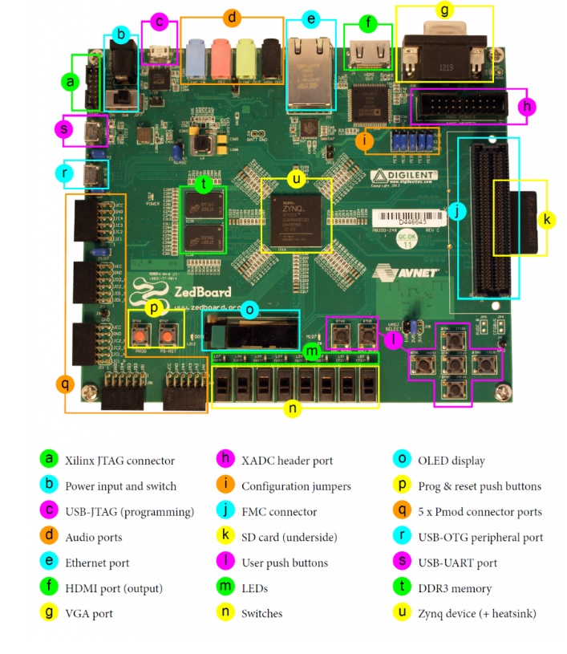
Physical overview of Zedboard

Slide 26
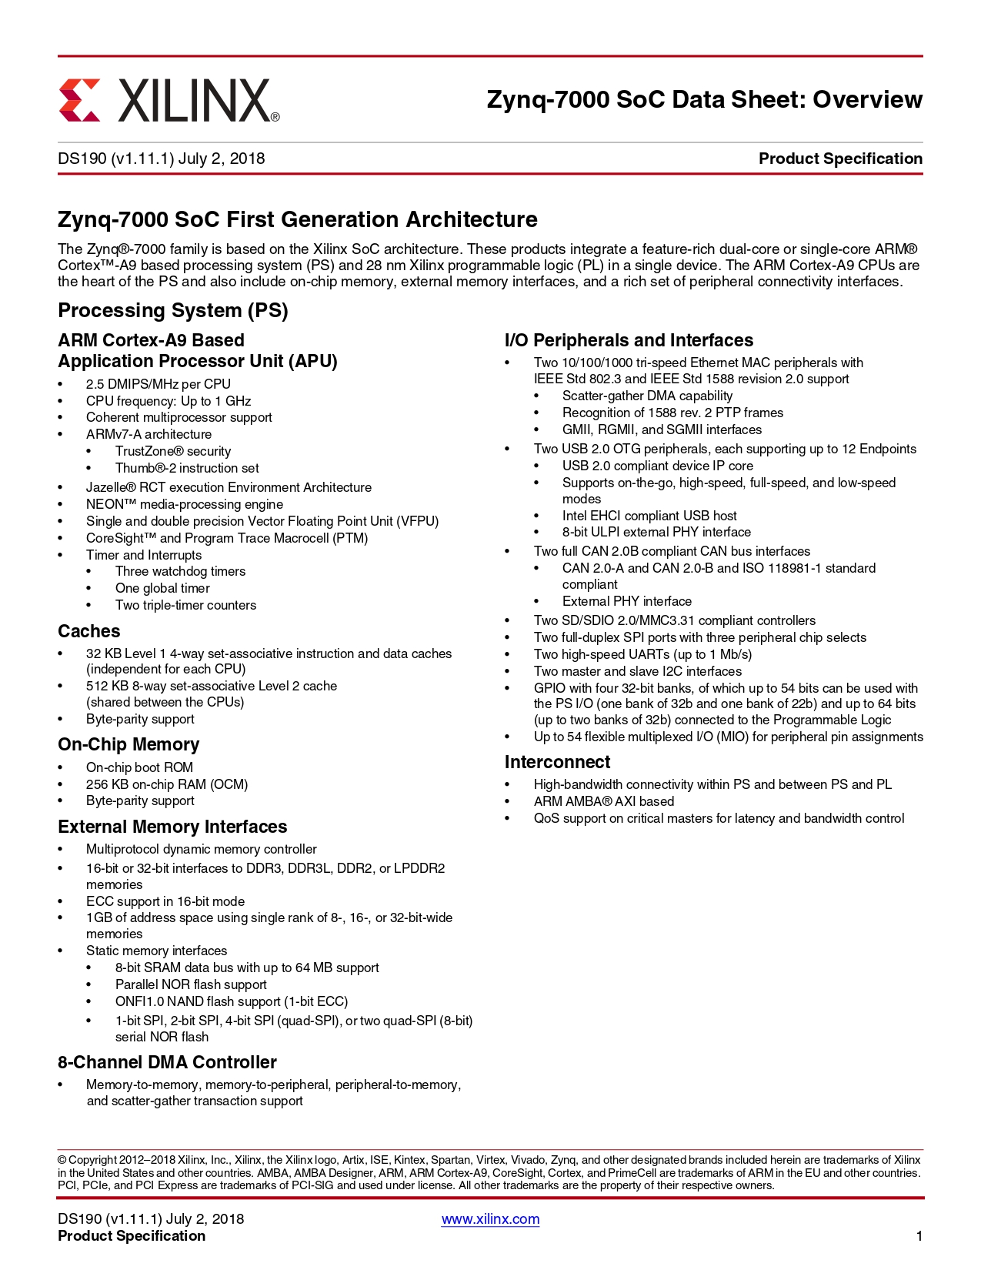
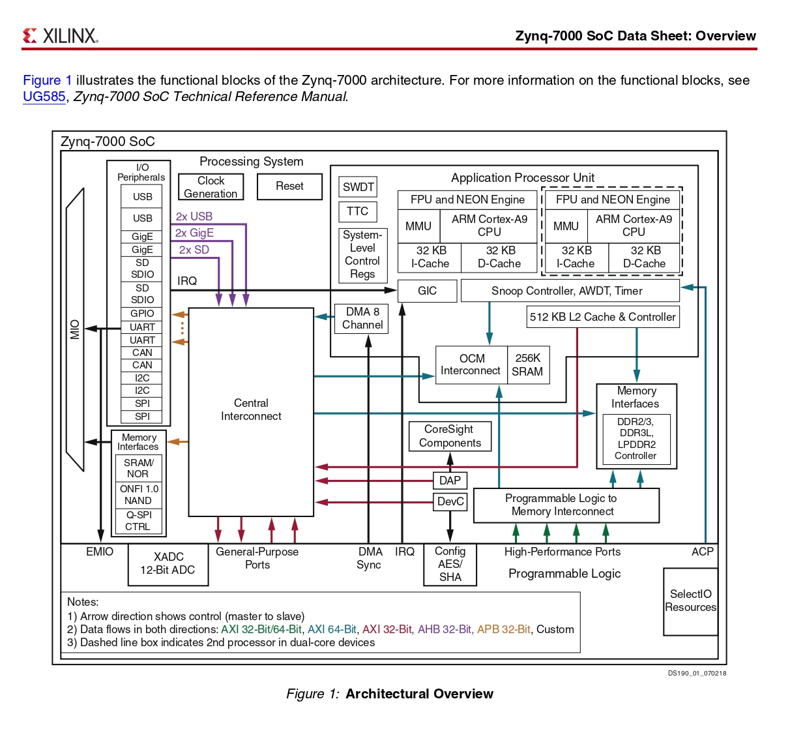
Zynq-7000 Data Sheet

Slide 27
K-Means Clustering
K-Means Clustering is an Unsupervised Learning algorithm, which groups the unlabeled dataset into different clusters.
It is an iterative algorithm that divides the unlabeled dataset into k different clusters in such a way that each dataset belongs only one group that has similar properties.
The algorithm takes the unlabeled dataset as input, divides the dataset into k-number of clusters, and repeats the process until it does not find the best clusters. The value of k should be predetermined in this algorithm.
It is a centroid-based algorithm, where each cluster is associated with a centroid. The main aim of this algorithm is to minimize the sum of distances between the data point and their corresponding clusters.

Slide 28
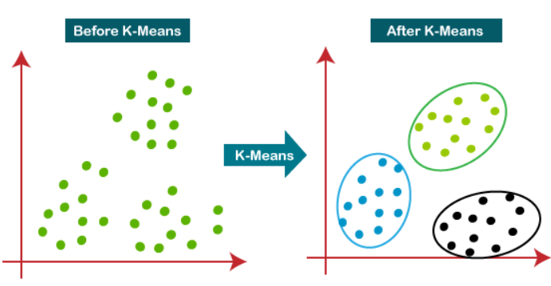
K-means Clustering
The k-means clustering algorithm mainly performs two tasks:
Determines the best value for K center points or centroids by an iterative process.
Assigns each data point to its closest k-center. Those data points which are near to the particular k-center, create a cluster.
Hence each cluster has datapoints with some commonalities, and it is away from other clusters.

Slide 29
Hardware and Software Co-design of K means algorithm
We divided the algorithm of K-means into two components one that will be handled by the software part and the other on the hardware.
For verification of our idea we did the prototyping on the Zedboard.
Hardware Design:
A dedicated comparison block is set up to compare any large sets of data.
Software Design:
In this we will be writing instructions to calculate the initial clusters and centroids.
Now based on the distances between the centroids and the points an iterative algorithm will be run till all the closely related data are placed in a same cluster.

Slide 30
Data set and expected results
Data is send from PS to bram that will be 8 values of distance.
Points taken for clustering are :- a=(1,1);b=(2,6);c=(2,3);d=(4,5);
Initial clustering taken as (0,0,1,1) or (a and b) & (c and d)
Therefore initial centroid values :- c1=(1.5,3.5),c2=(3,4).
Distance PL is supposed to calculate during 1st iteration:- ac1=2.5495,ac2=3.6056,bc1=2.549,bc2=2.2361,cc1=0.7071,cc2=1.414,dc1=2.9155,dc2=1.414
Data which we should get form BRAM (written by PL) would be (0,1,0,1)
So, cluster regrouped after 1st iteration (a and c) & (b and d)
For iteration 2 we will get the new centre as c1=(1.5,2),c2=(3,5.5).
Distance PL is supposed to calculate during 2nd iteration:- ac1=1.118,ac2=4.924,bc1=1.118,bc2=2.6926,cc1=3.905,cc2=1.118,dc1=4.0311,dc2=1.118
Data which we should get from BRAM would be (0,1,0,1)
After 2nd iteration the error function will become zero and iteration will be completed. So, expected result will be:-
Cluster of point a=1
Cluster of point b=2
Cluster of point c=1
Cluster of point d=2

Slide 31
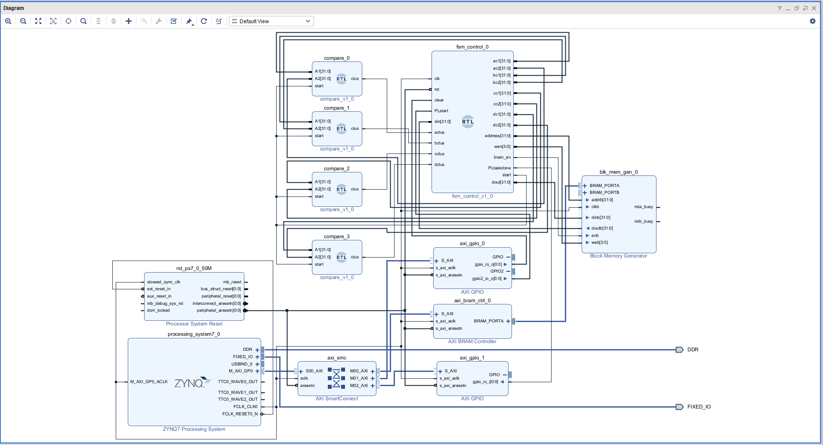
Design-1 Block Diagram

Slide 32
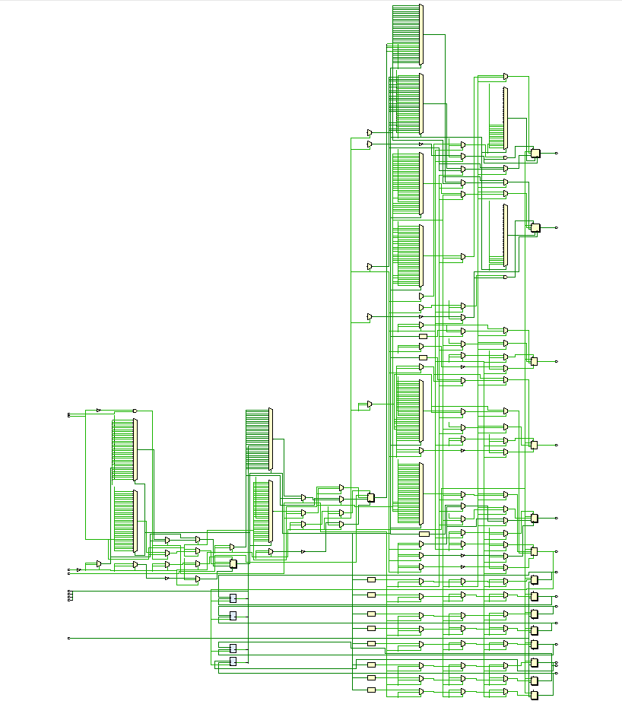
RTL (Only PL part)

Slide 33
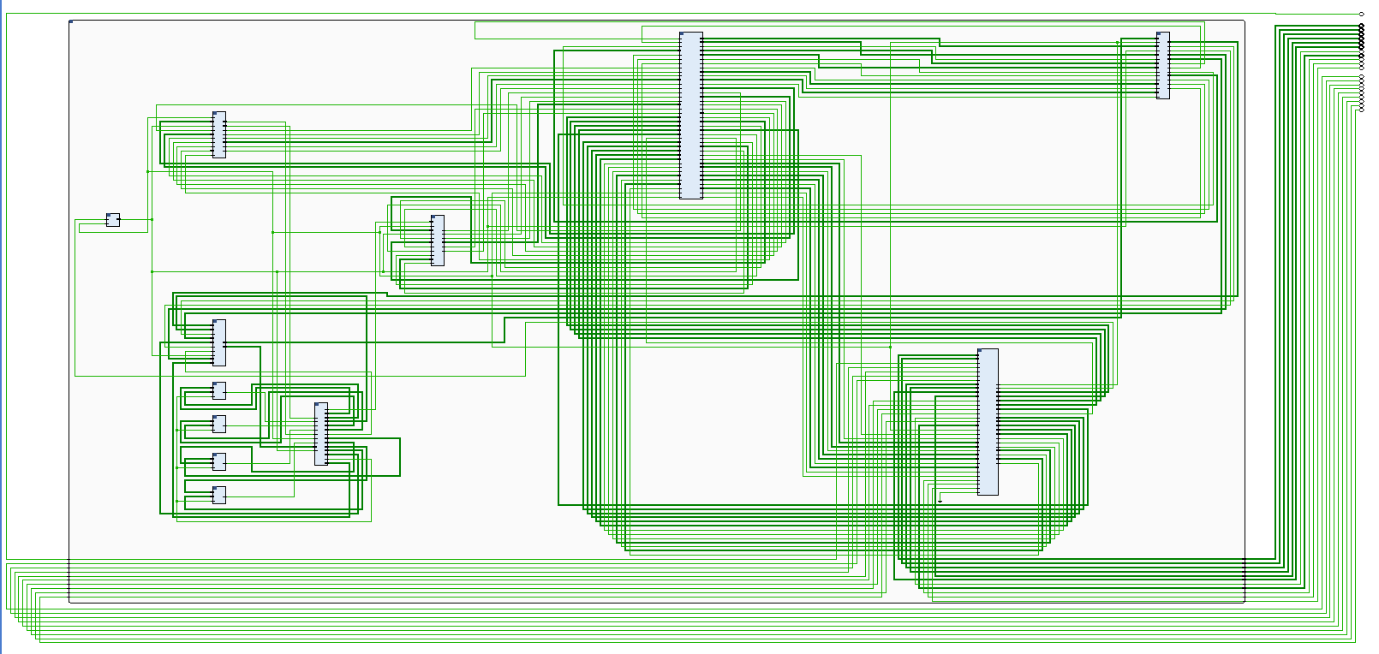
Implemented Design Schematic

Slide 34
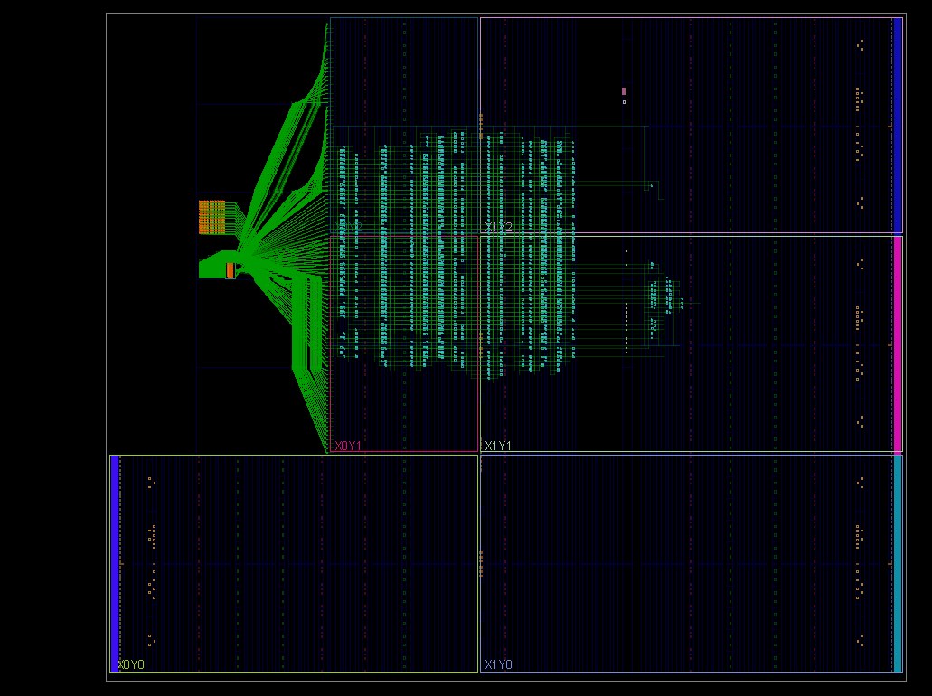
Device Mapping

Slide 35
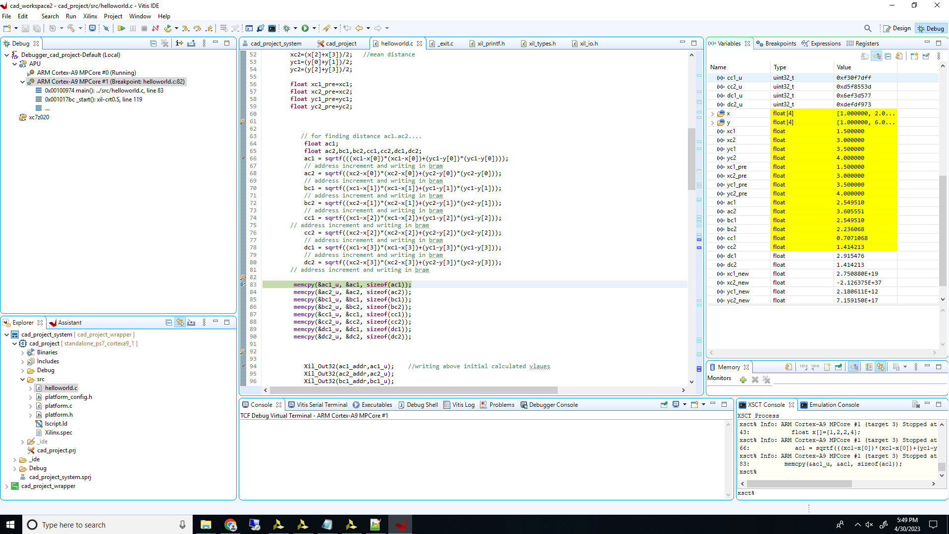
Vitis IDE Debugging Results

Slide 36
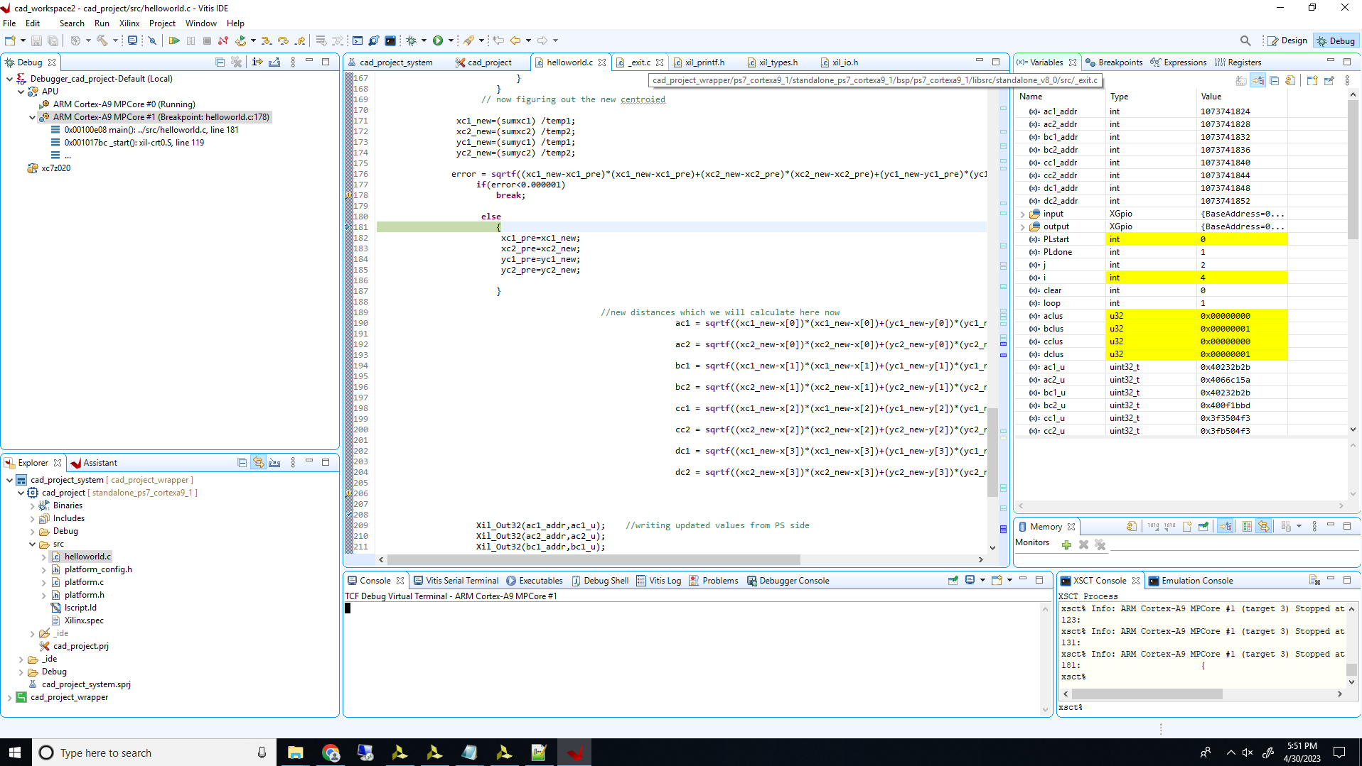
Vitis IDE Debugging Results

Slide 37
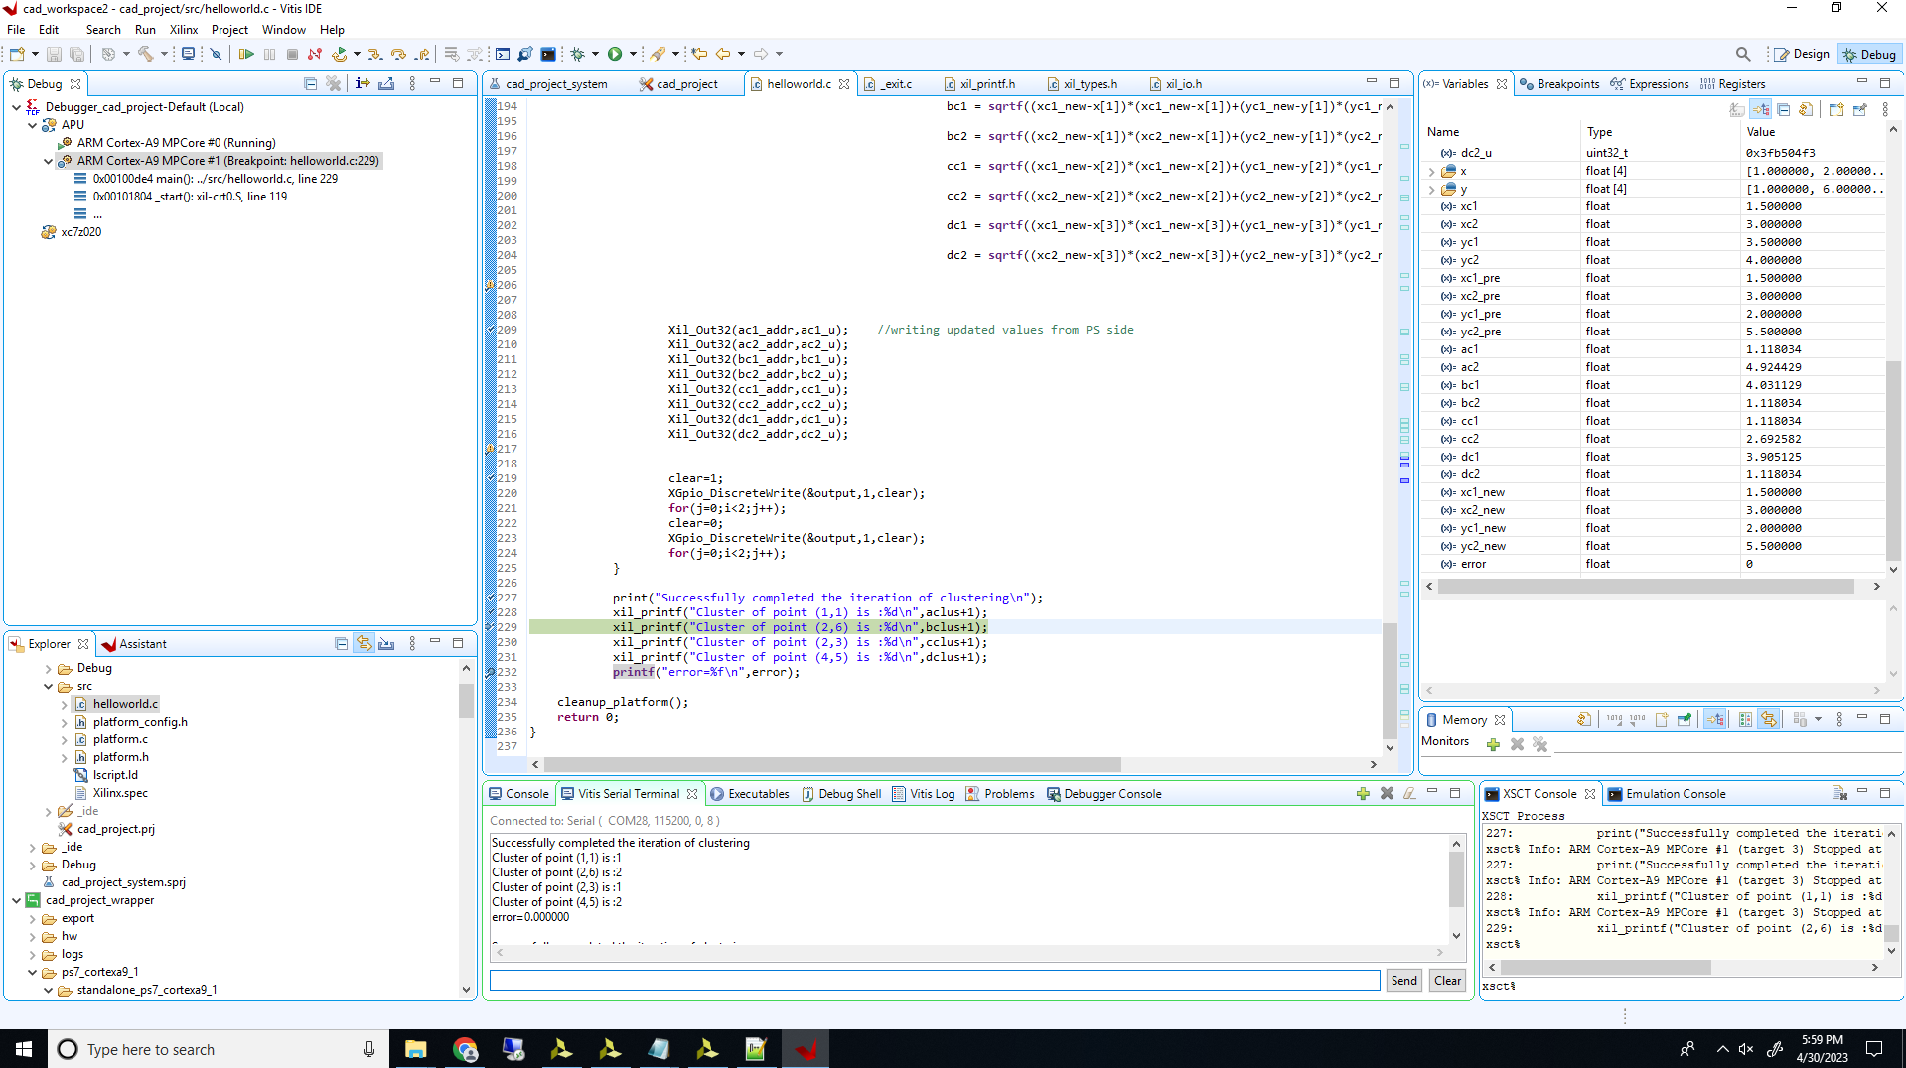
Vitis IDE Debugging Results

Slide 38
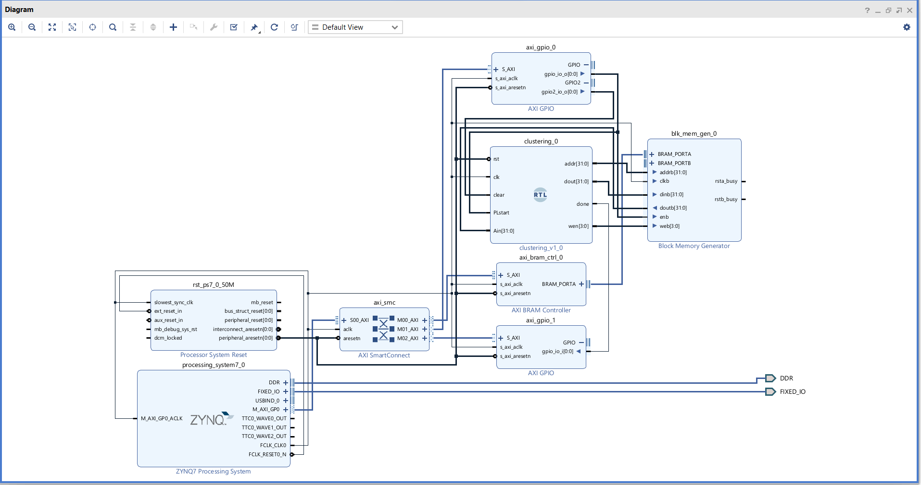
Design-2 Block Diagram

Slide 39
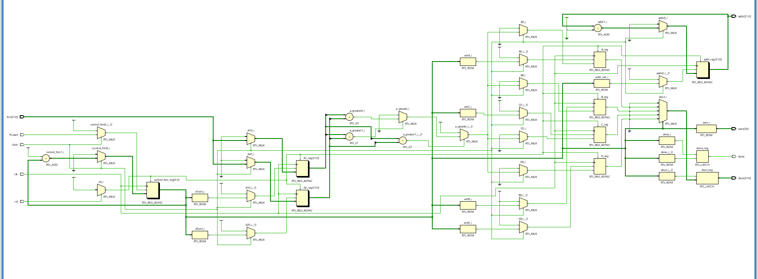
RTL (Only for PL part)

Slide 40
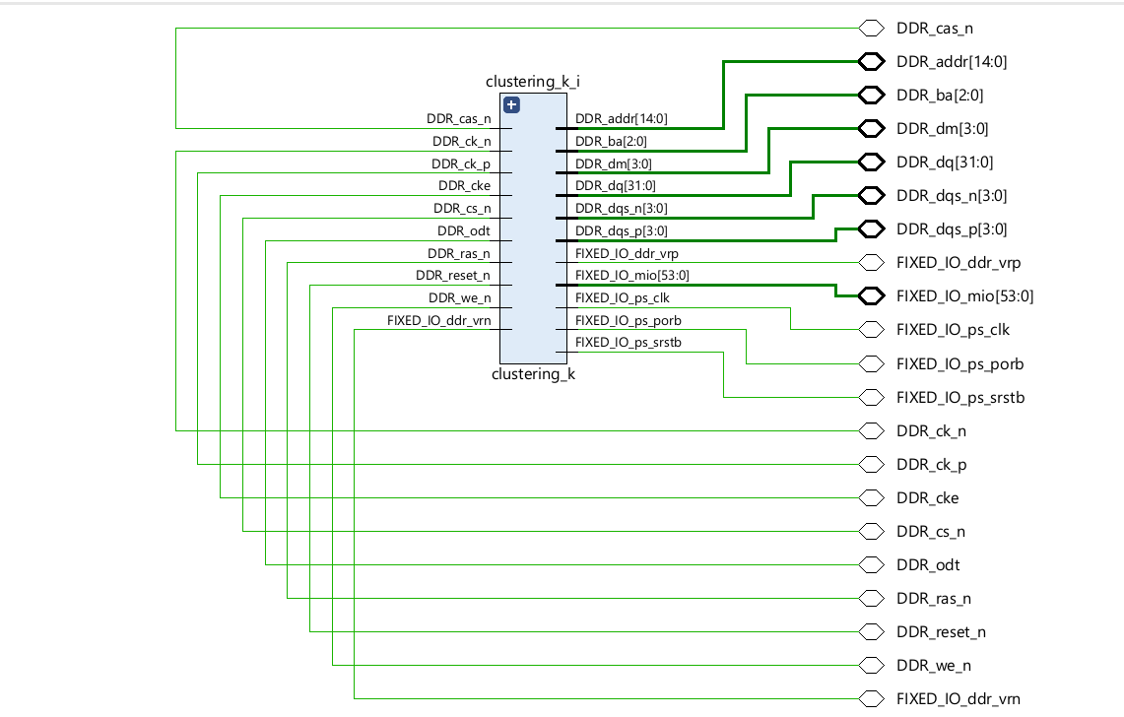
Implemented Design Schematic

Slide 41
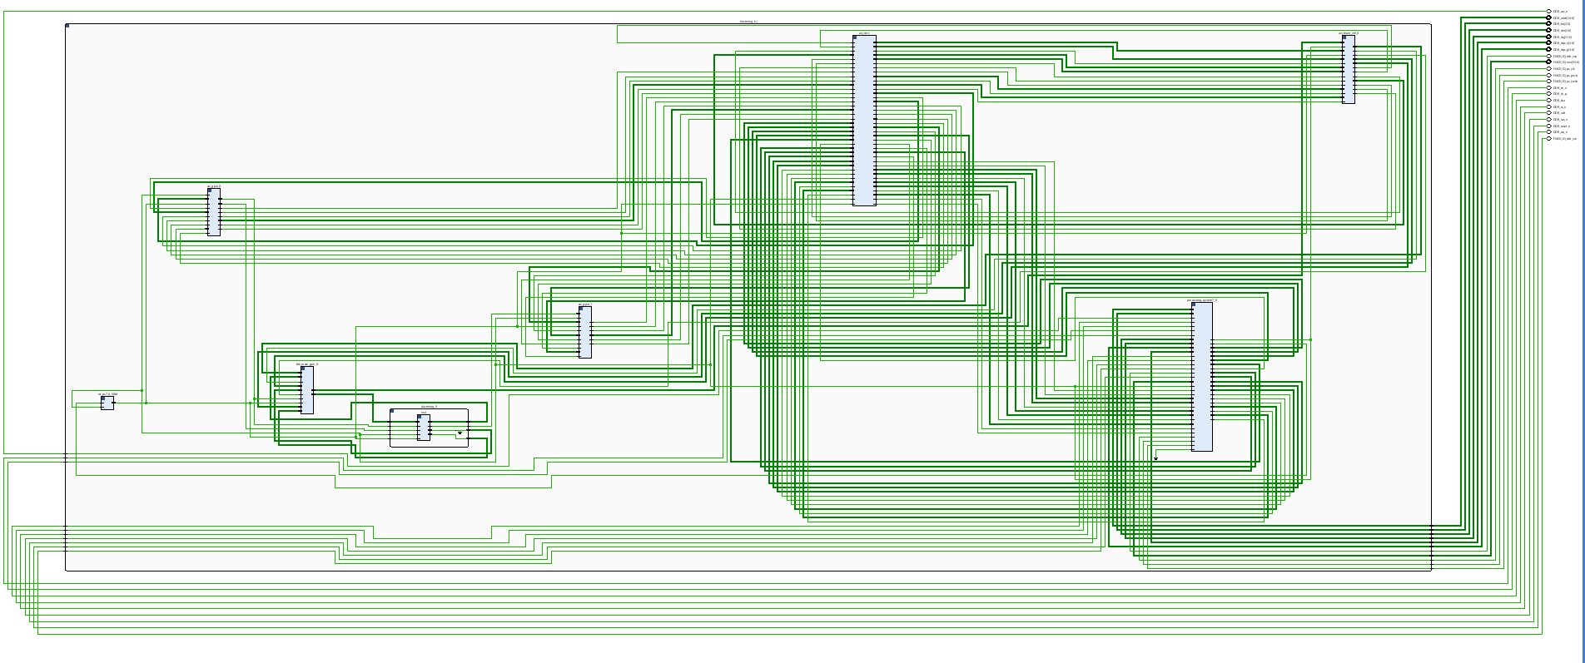
Implemented Design Schematic

Slide 42
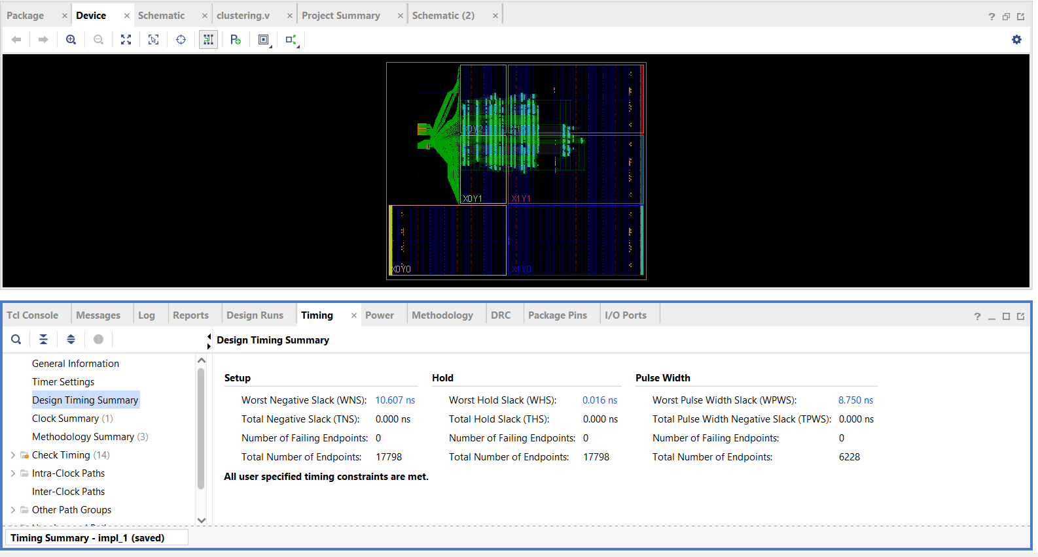
Device Mapping

Slide 43
Vitis IDE Debugging Results

Slide 44
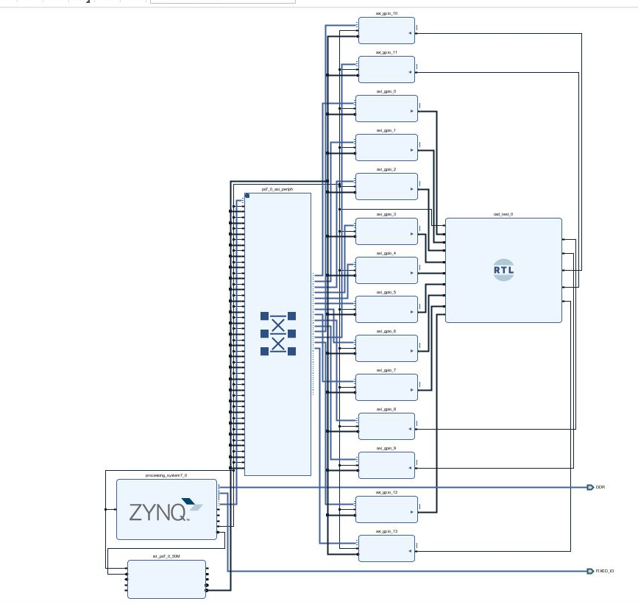
Design-3 Block Diagram

Slide 45
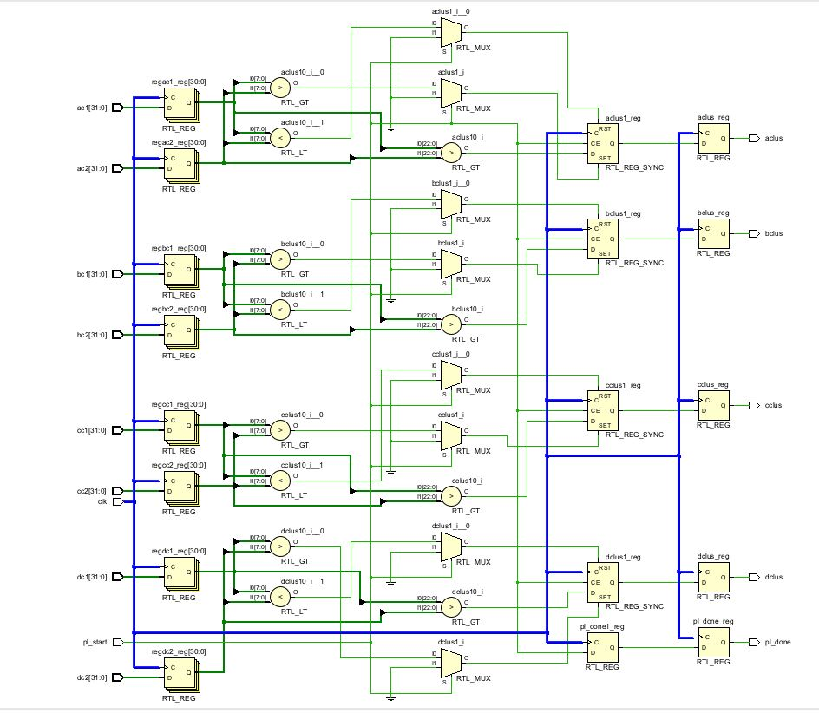
RTL (Only for PL part)

Slide 46
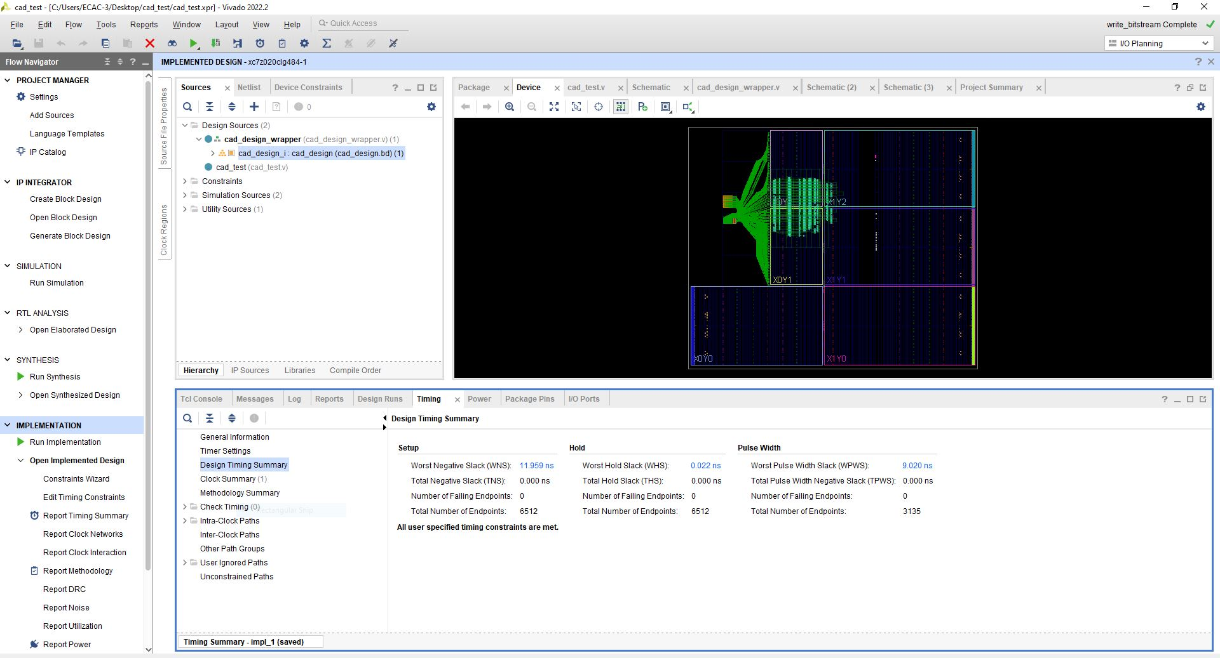
Device Mapping

Slide 47
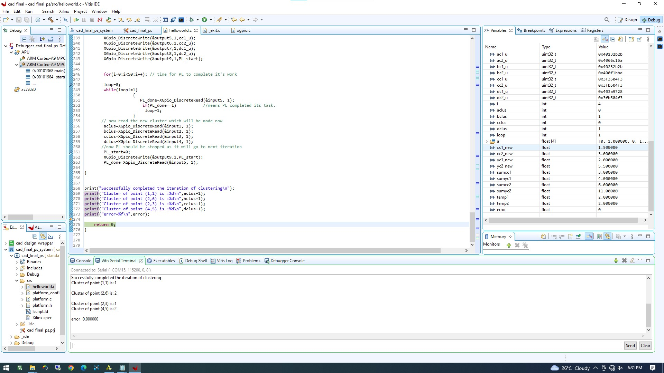
Vitis IDE Debugging Results

Slide 48
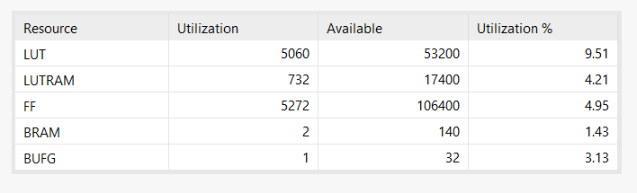
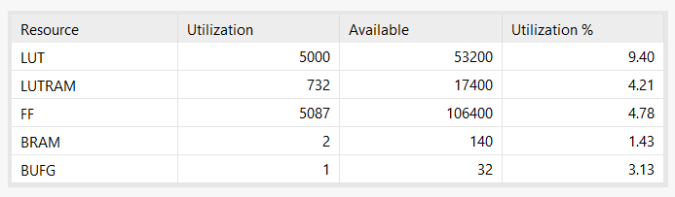
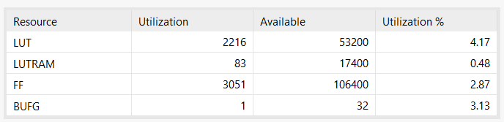
Device Utilization
Design-1
Design-2
Design-3

Slide 49
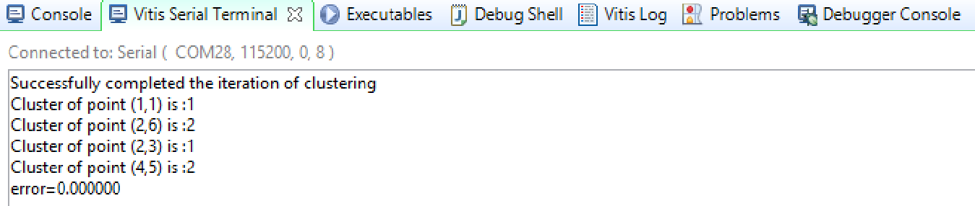
Conclusion
Therefore , the results obtained in our debugging run matches the expected result of our dataset mentioned earlier.
Through this project we learned and successfully implemented a small unsupervised learning algorithm involving hardware software co-design, implemented on Vivado and Vitis IDE.

Slide 50
Learning outcome
During the process of completing this project we learned to work in an integrated development environment by Xilinx Vitis and also learned to do better hardware designing on Vivado HDL platform.
We would also like to list few advantages of hardware software co-design realized during the process of completion of this project:
Improved performance: Hardware-software co-design allows for hardware and software to be optimized together, resulting in better performance than when designed separately.
Reduced costs: Co-design allows for better resource utilization, as hardware and software are designed to work together efficiently. This can lead to reduced costs in terms of hardware, software development, and system integration.
Faster time-to-market: Co-design allows for better collaboration between hardware and software teams, which can result in faster development times and faster time-to-market for products.
Improved reliability: Hardware-software co-design can lead to more reliable systems as hardware and software are designed to work together seamlessly.
Flexibility: Co-design allows for greater flexibility in the system design, as hardware and software can be designed to adapt to changing requirements and constraints.

Slide 51
Thank You

